Slide 1
Web mining

Slide 2
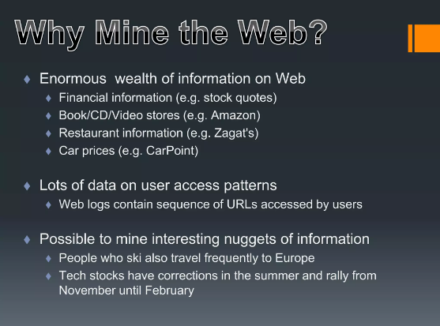

Slide 3
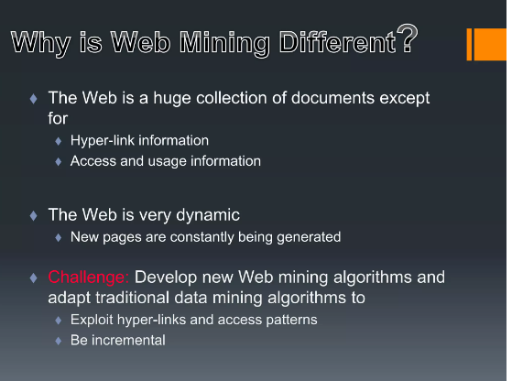

Slide 4
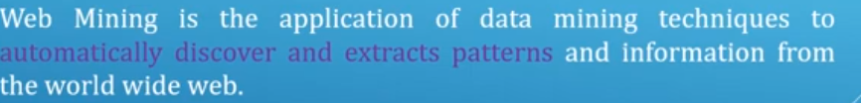
Web mining

Slide 5
Web mining contd..
It has three operations of interests--- clustering(EX: finding natural grouping of users,pages etc), associations(Which urls are requested together) and sequential analysis(what order the urls were accessed)

Slide 6
Types
Web content mining
Web structure mining
Web usage mining

Slide 7
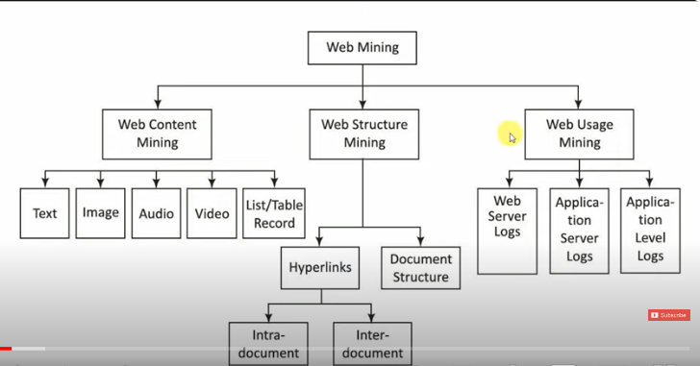

Slide 8
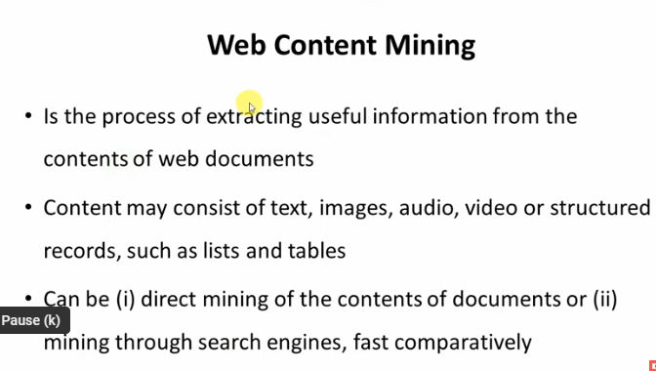

Slide 9
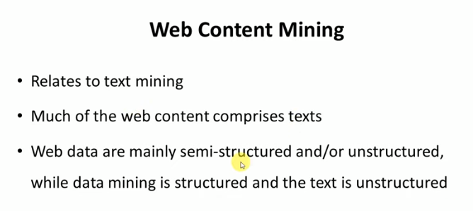

Slide 10
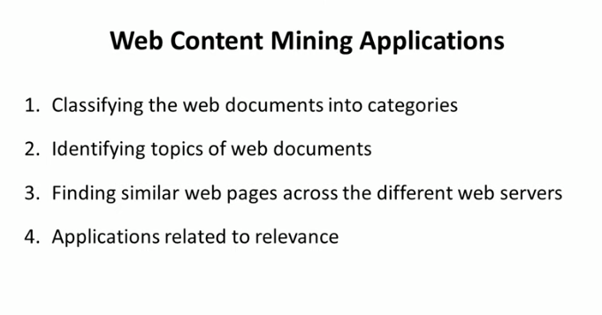

Slide 11
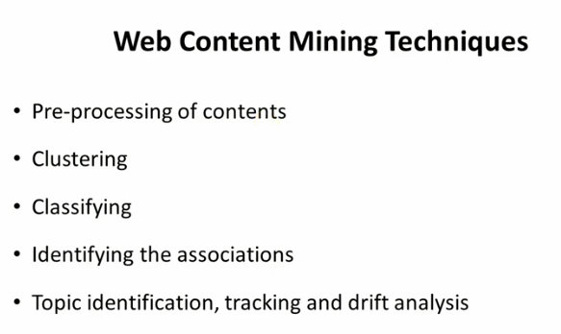
Drift is the change over time in the statistical properties of the data that was used to train a machine learning model.

Slide 12
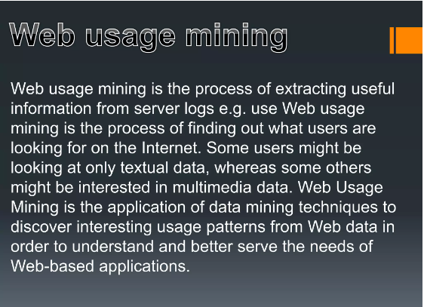

Slide 13
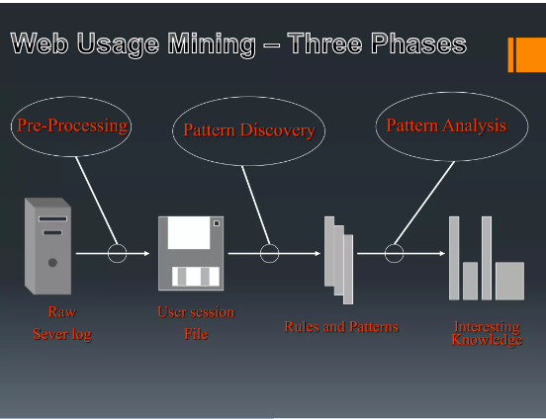

Slide 14
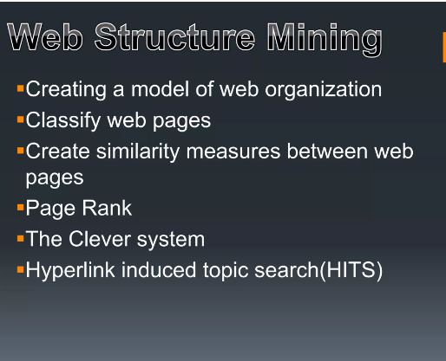

Slide 15
Temporal and Spatial data mining

Slide 16
What is temporal data mining?

Slide 18
Types of temporal data

Slide 20
Temporal DM tasks

Slide 23
Temporal Association rules

Slide 25
Sequence mining

Slide 27
Sequence mining Problem

Slide 28
Sequence

Slide 29
Sub-Sequence

Slide 30
Frequency and frequent sequence

Slide 31
Example

Slide 32
One sequence fom previous table

Slide 33
All sequences

Slide 34
Min supp=2 find frequent subsequences

Slide 35
Spatial mining

